Slide 1
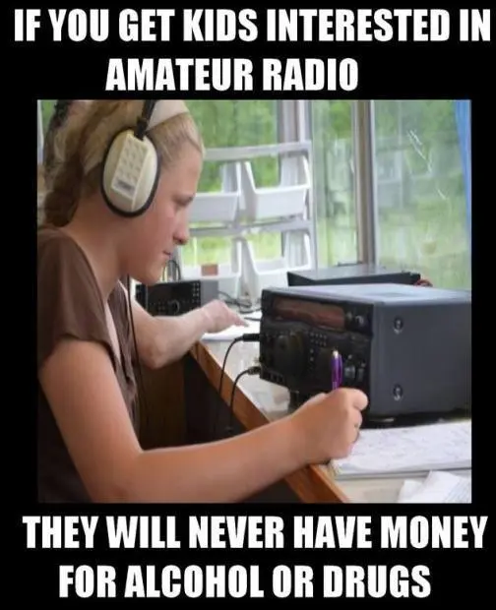
building a cyber range in GCP - and - the magic of 10 meter ham radio
Tom Costello @kd9cpb@infosec.exchange he/him/his kd9cpb.com
Panckakescon3 backup speaker, Pancakescon4 actual speaker!
Slides at github.com/kd9cpb/slides

Slide 2
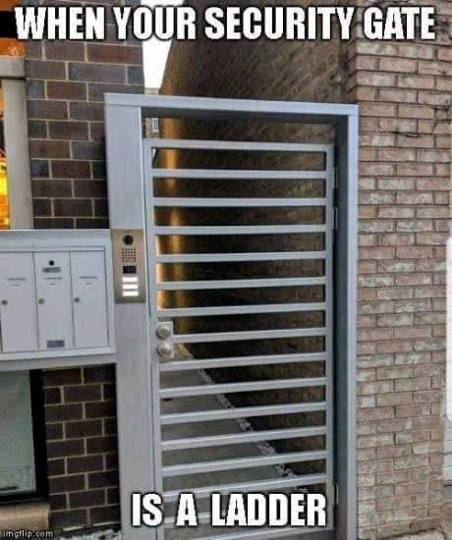
Who’s this dude and what is a cyber range?
Been into network security since DC14 + BackTrack Linux days
Blue Team FTW
Boring ”views & opinions” disclaimer goes here
“A cyber range is a controlled, interactive technology environment where up-and-coming cybersecurity professionals can learn how to detect and mitigate cyber attacks using the same kind of equipment they will have on the job.”
- cybersecurityguide.org

Slide 3
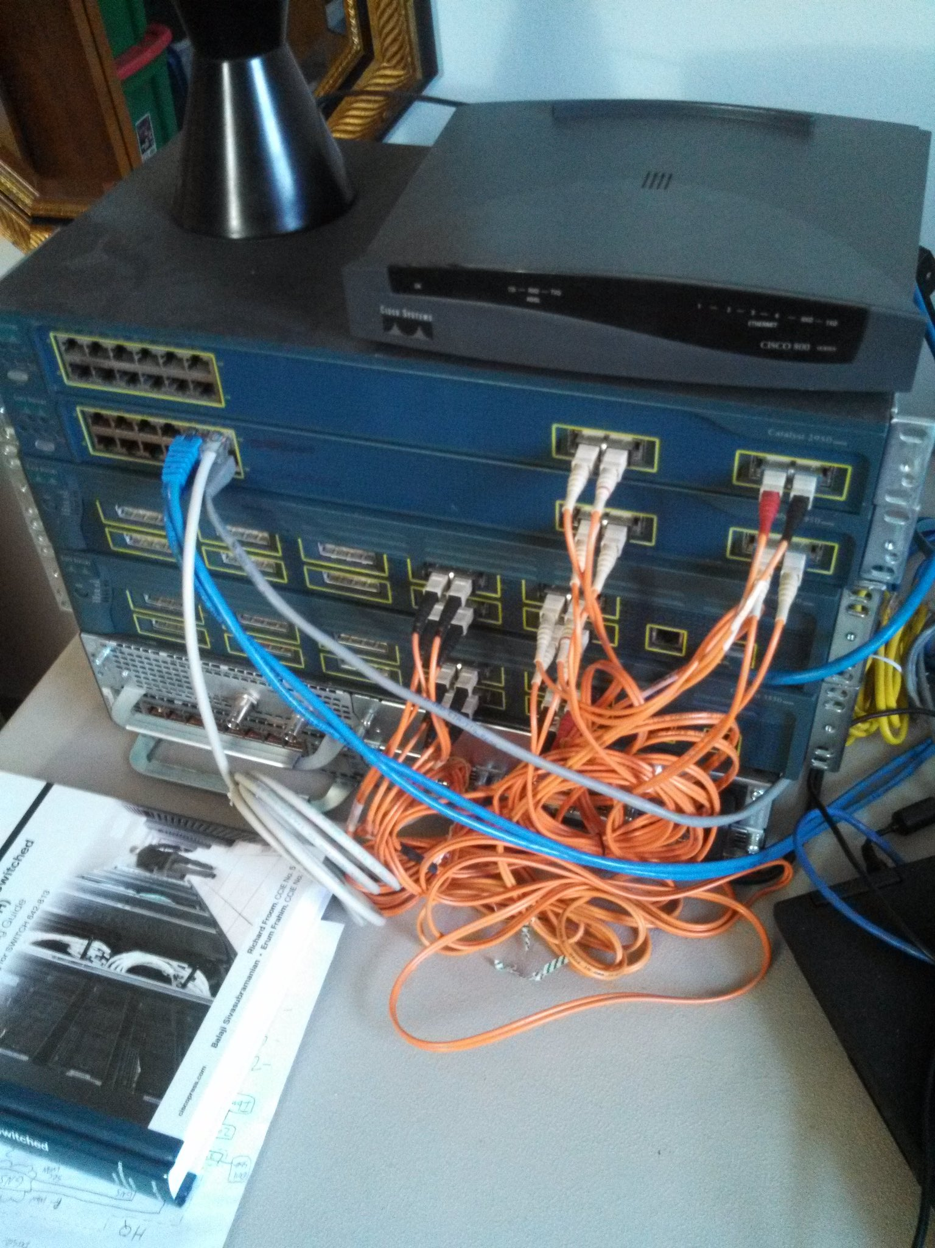
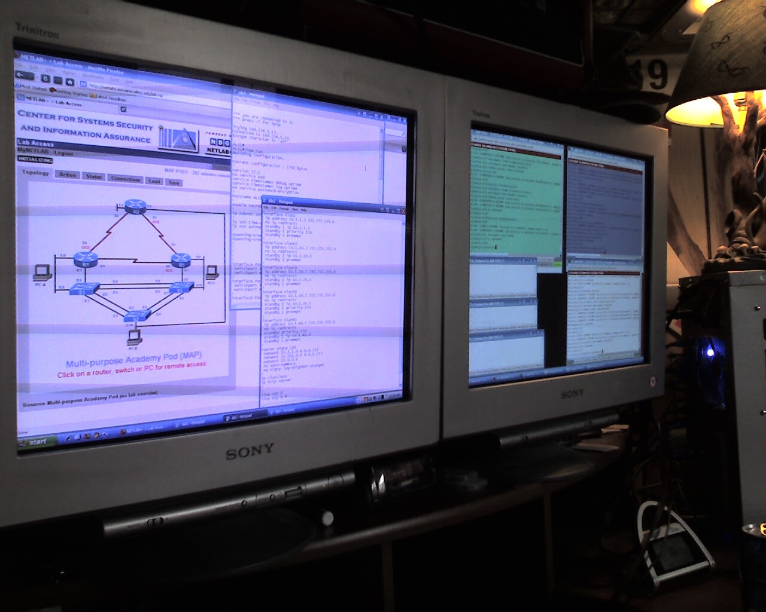
Humble Cyber Range Beginnings
I’ve been doing network security homelabs since mid-2000’s, they aren’t super exciting

Slide 4
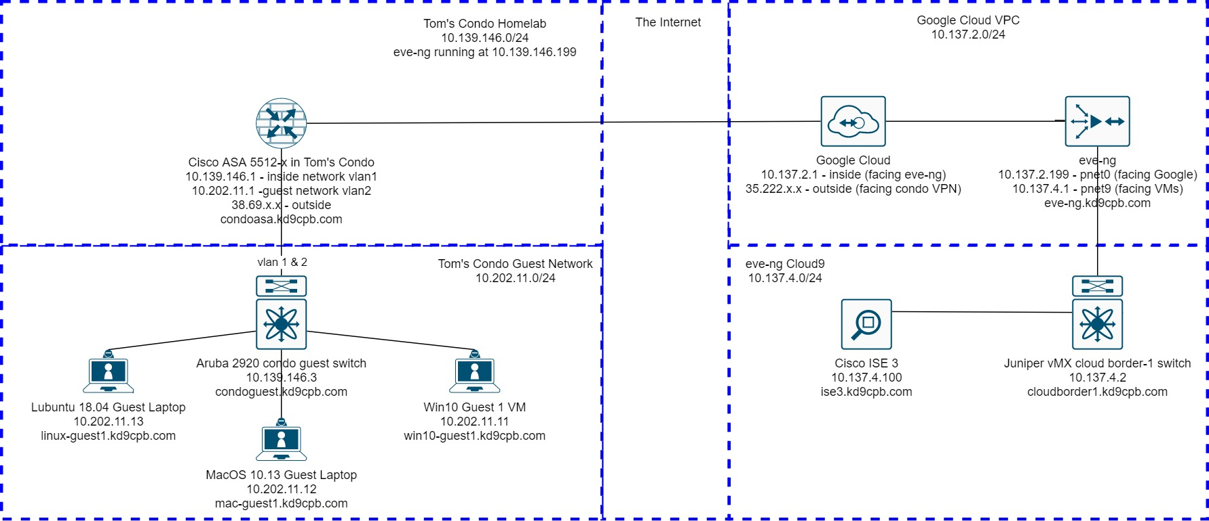
A GCP cyber range is born
Thanks to new gig in Summer 2020, found out about eve-ng in GCP as cyber range
This is exciting! Can add things to home wifi that can access things in cyber range
$300 Google Cloud New Customer Credit FTW

Slide 5

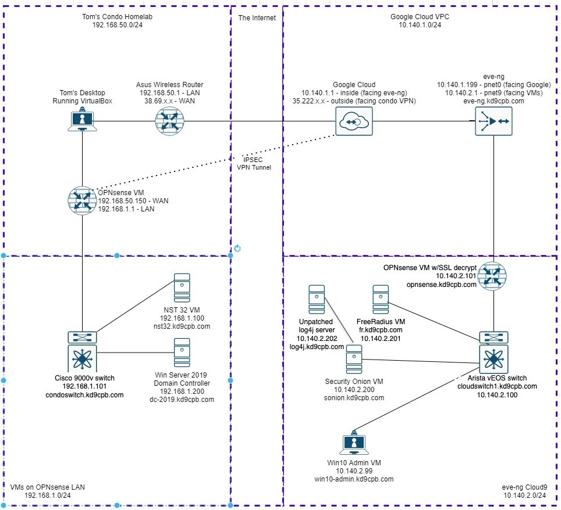
Doing it with free-ish stuff only

Slide 6




2 ways to connect btwn home & cyber range
GCP IPsec tunnel

Slide 7


2 different ways to BYO GCP cyberrange
Option 1: Tony E’s videos at https://youtu.be/alATWfvyJmE
Best if you want to get running ASAP
Just works out of the box, no messy tunneling
This is the blue pill
Option 2: my blog at https://kd9cpb.com/opnsense-eve-gcp
Best if you want to really learn GCP networking
It’s messy, but you will learn a ton about cloud networks & OPNsense firewall
This is the red pill

Slide 8



So you built a GCP cyber range, now what?
Write your own Python/Ansible automation to do your work for you per https://kd9cpb.com/automate-gcp-eve
See if your favorite NGFW/IDS actually detects vulns log4j, Bluekeep, etc. on an unpatched system in range
Try different network vendor’s stuff for free per https://ethancbanks.com/free-networking-lab-images-from-arista-cisco-nvidia-cumulus/
Test if an ACL or security policy change breaks stuff without breaking things in the real-world
Eve-ng isn’t the only game in town; check out containerlab or gns3 too

Slide 9

Please type cyberrange Questions into Slack now before we go into radio fun!

Slide 10
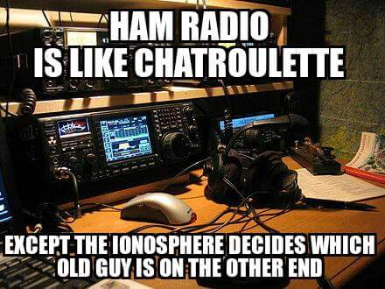
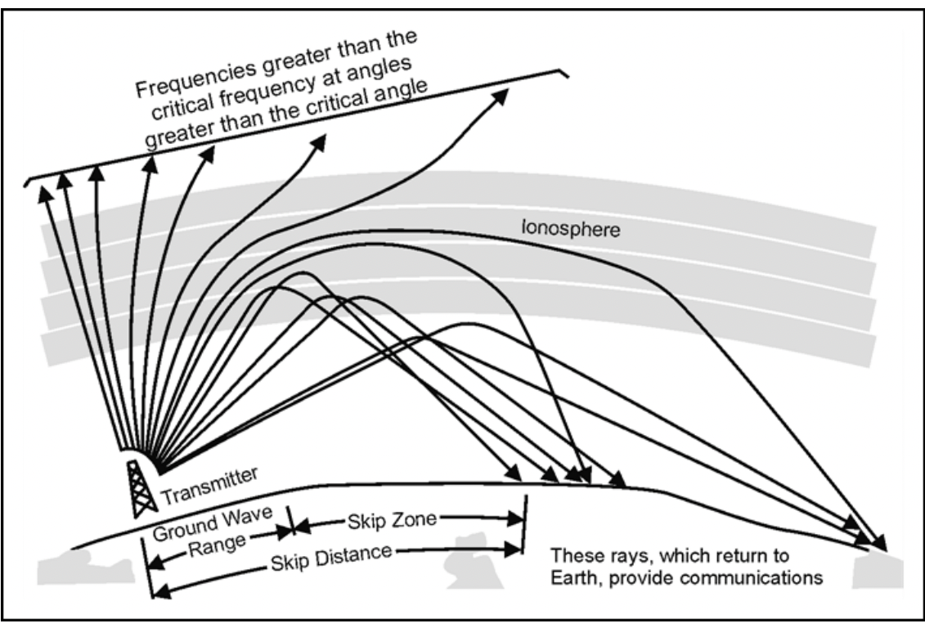
The magical 10 meter band in ham radio
Full story of why HF is awesome at https://armypubs.army.mil/epubs/DR_pubs/DR_a/pdf/web/ARN20819_ATP_6-02x53_FINAL_WEB.pdf

Slide 11

How do I start blasting RF into the ionosphere?
Step 1: Get a ham radio license
Step 2: Get a radio, antenna and adapters
Step 3 (optional): Get WSJT-X working on your computer
Step 4 (optional): Get QSL cards or electronic logbook
If you just want to take a listen for now, buy an SDR dongle (should be less than $50, search rtl-sdr or nooelec smart)

Slide 12

Step 1 option 1: Getting a license via memorization
Either web search for “Chicago ham radio volunteer examiner” (substituting out Chicago for your town, unless you are in Chicago)
Or do it online (proctored) via orgs like https://kl7aa.org/vec/ and https://www.w5yi.org/
Use hamstudy.org (or similar) to memorize technician question pool

Slide 13
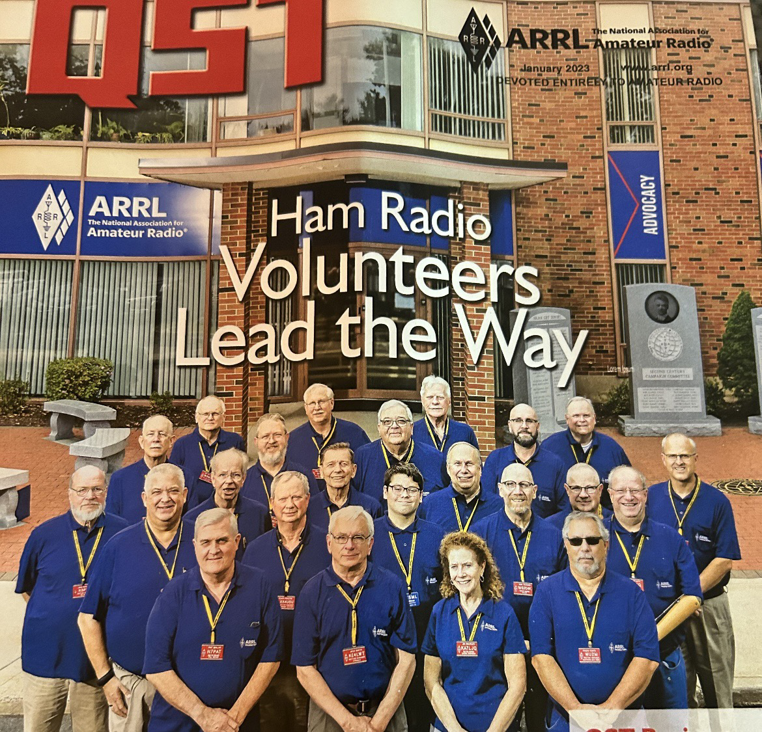

Step 1 option 2: Getting a license via studying Ria’s book
Ham radio has an inclusivity problem. It’s gotten better since the pandemic, but still an issue
Ria Jairam N2RJ making waves at ARRL, wrote awesome book on passing technician exam by truly understanding the fundamentals (not just memorizing!)
Check out https://perens.com/2023/01/14/director-ria-jairam-recused-by-arrl-and-it-seems-political-to-me/ for some great ham radio drama

Slide 14
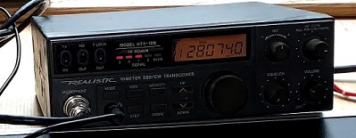
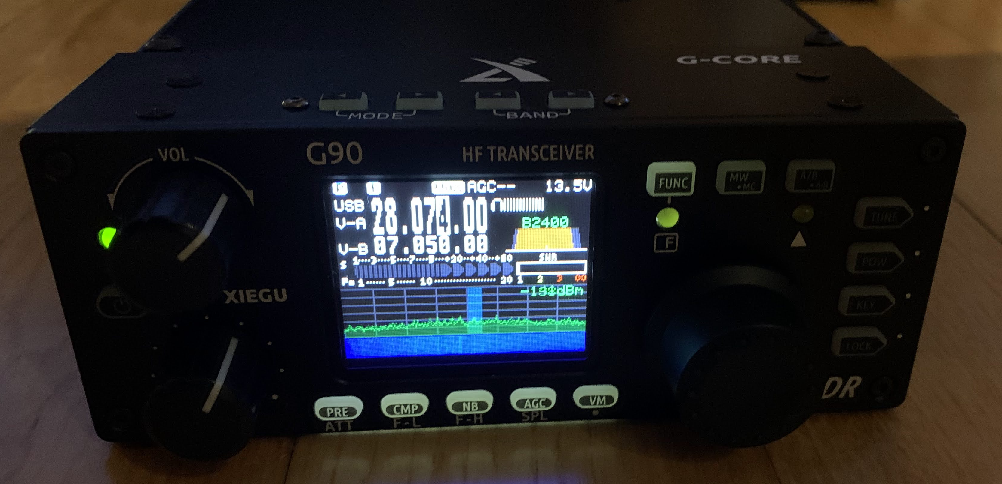
Step 2: Get a radio, antenna, adapters
Option 2: Go fancy with an expensive all-band HF ham radio with a tuner
https://kd9cpb.com/g90 has my all-band setup if you’re curious, $500+ to get started
”Buy once, cry once” if you get General level license (way more studying)
This is the red pill
Option 1: Go cheap and get a 10 meter ham radio
https://kd9cpb.com/10m-ft8 blabs about this, it’ll cost between $150 – 450
If you don’t like it, you can put it all back on eBay at a small loss
This is the blue pill

Slide 15
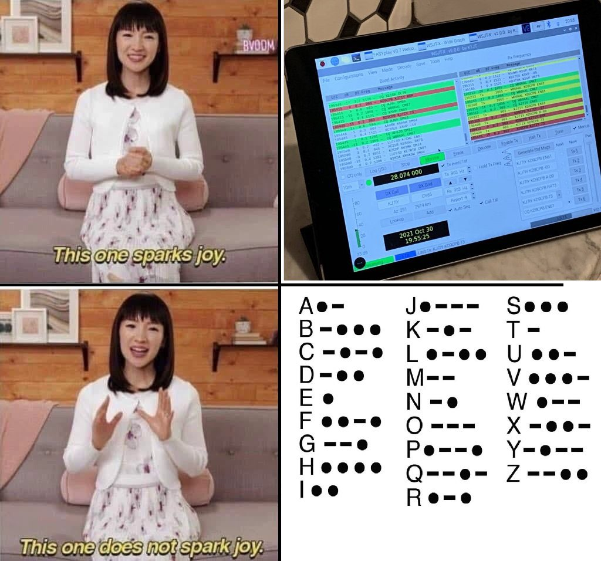
Step 3: WSJT-X
Makes magical bagpipe noises from your computer’s mic jack
Listens for magical bagpipe noises from around the world
When you send and receive noises, it counts as a QSO!
Similar programs like JS8call exist to have actual conversations with the world
No morse code required
YouTube Tutorials are your friend

Slide 16
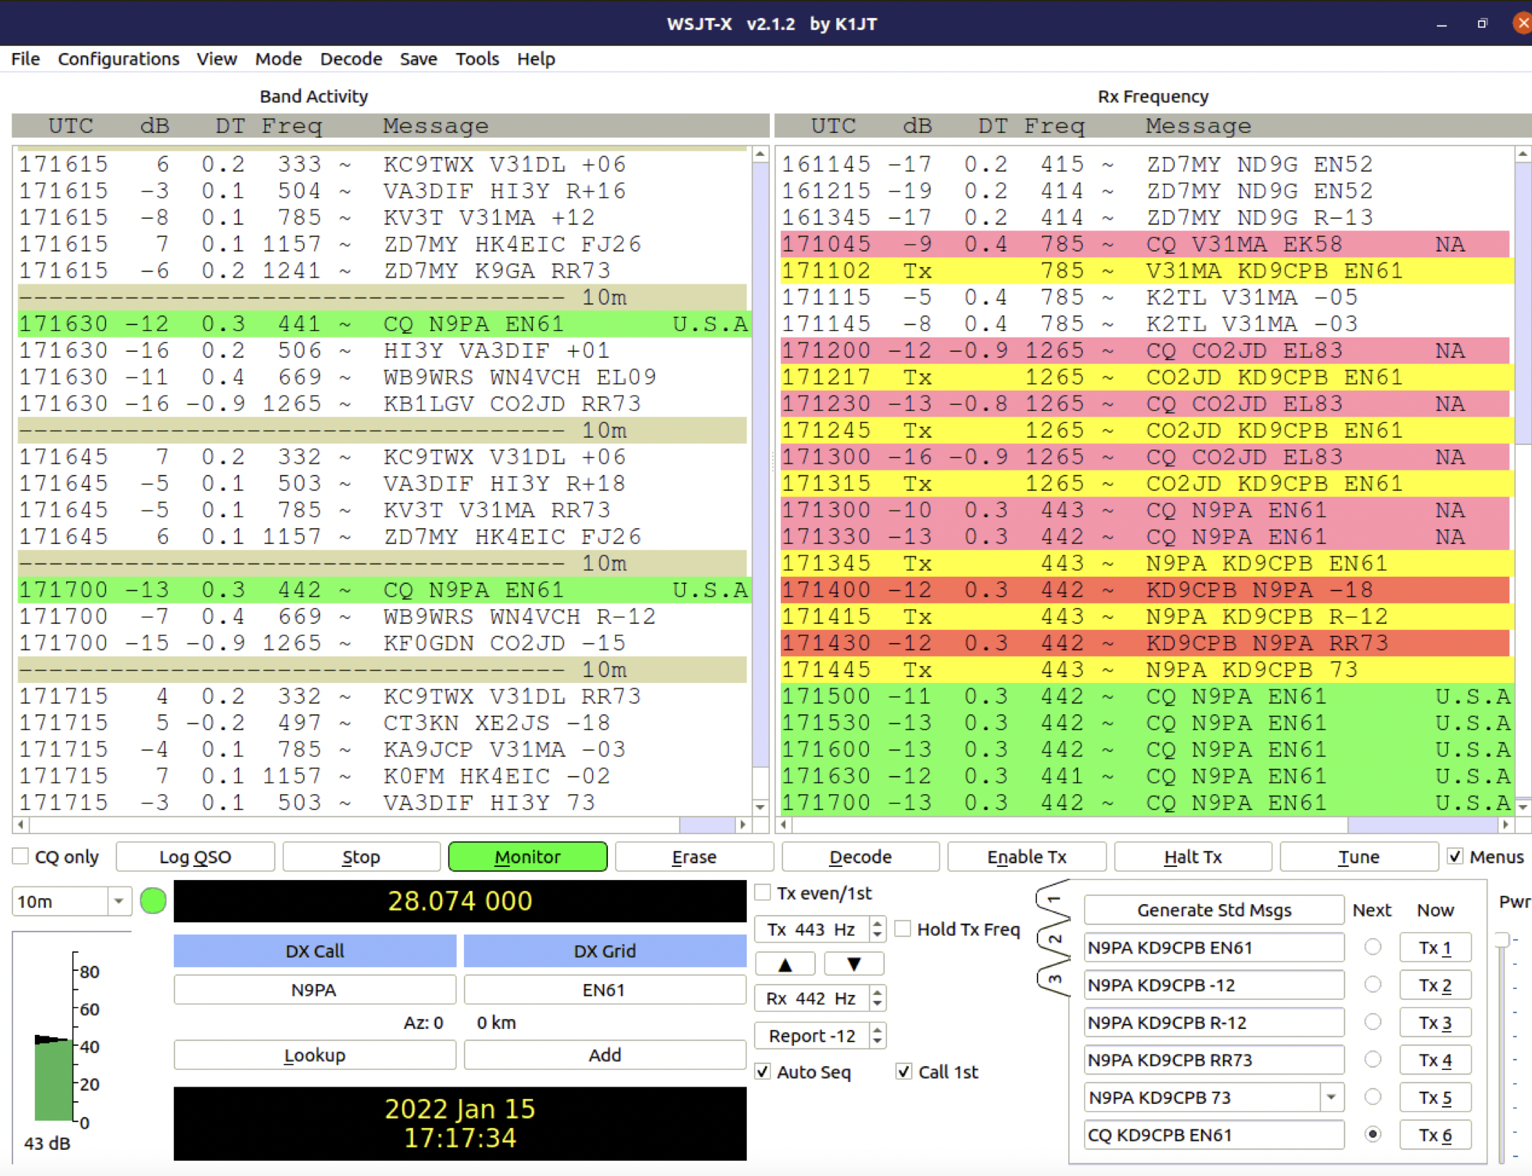
What a good 10 meter FT8 QSO looks like

Slide 17
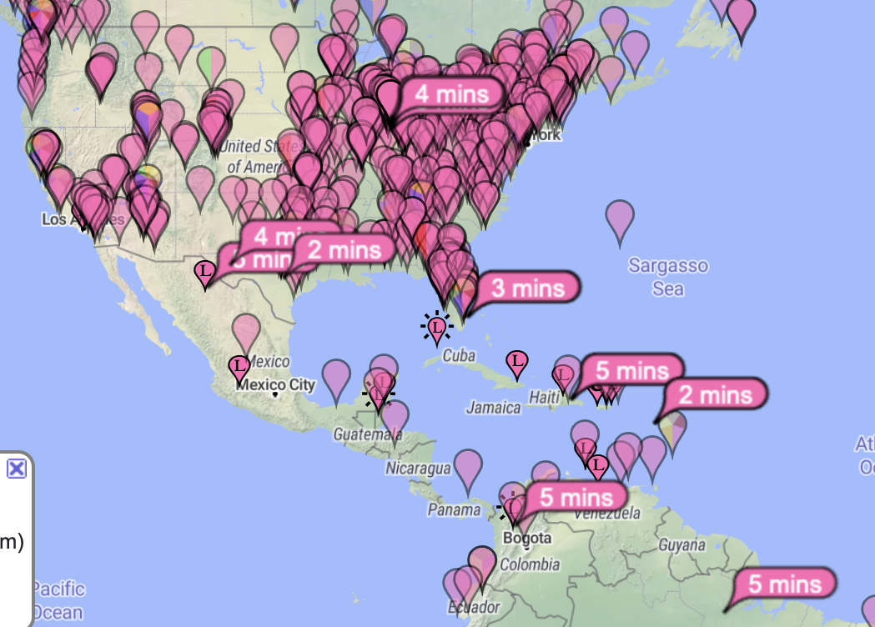
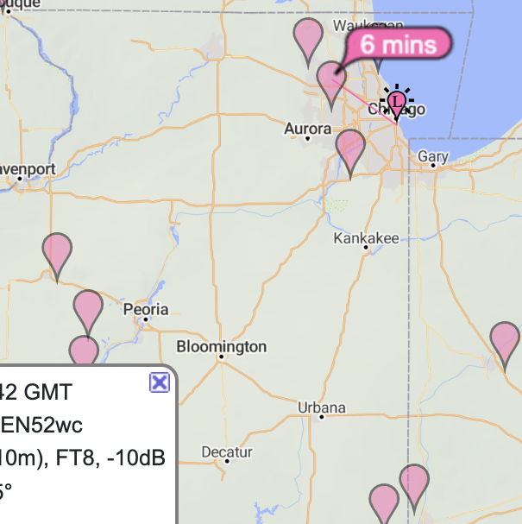
Your 10 meter milage may vary

Slide 18
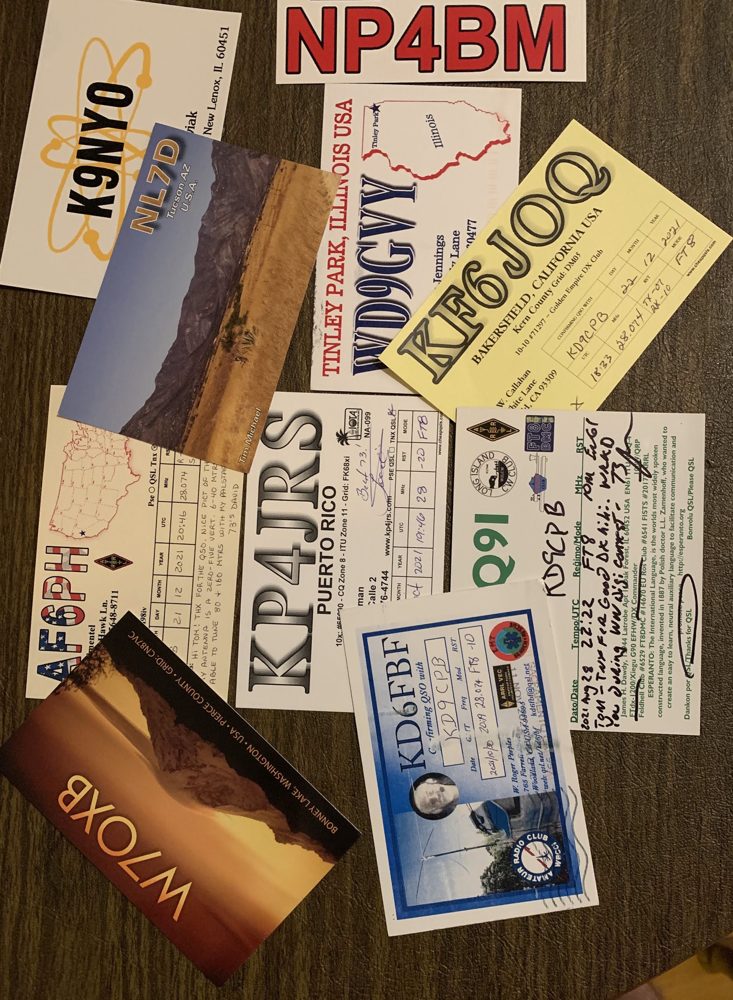
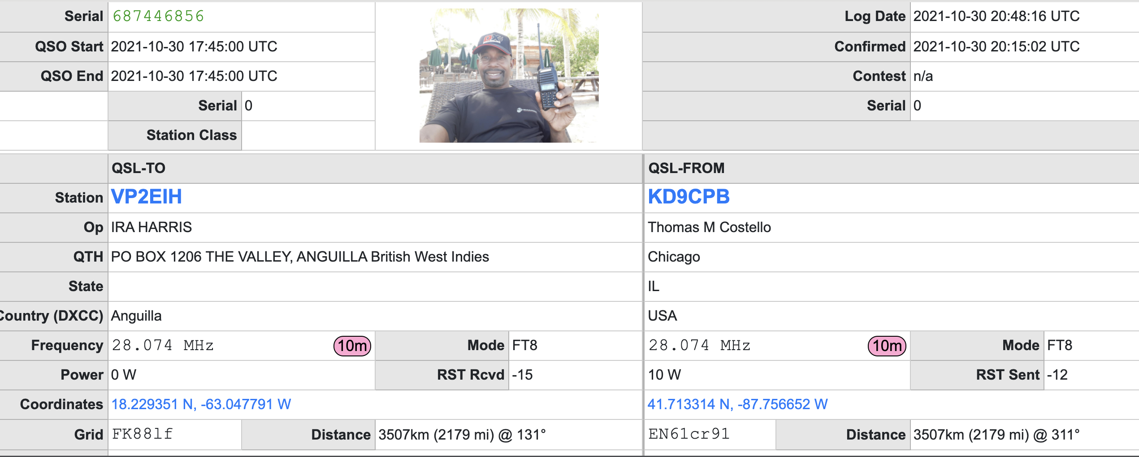
Step 4: QSL cards or electronic logging
QSL cards are a fun hobby but not ideal for privacy
eQSL services like QRZ, LoTW and eQSL.cc are very popular, no postage!

Slide 19

Last slide I promise
Thanks for watching! Slides at github.com/kd9cpb/slides
Check out PancakesCon2’s ISS Ham Radio talk at https://www.youtube.com/watch?v=9r8M-AUks50
Seriously after Pancakescon consider spending your $300 free GCP credit on building a cyberrange
Then spend $300ish real money on 10 meter ham radio gear after the GCP credit runs dry ☺
Hit me up @kd9cpb@infosec.exchange or qrz.com
Have a nice day!

